Slide 1
Traditional and
Big Data
Shahriar’s Analytical Academy

Slide 2
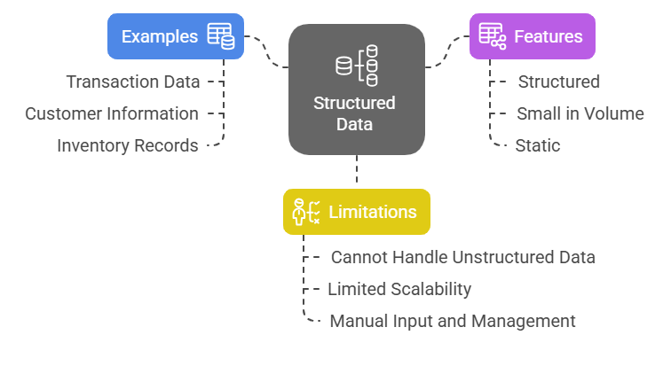
Traditional Data
Traditional data refers to structured data that is typically stored in relational databases and is organized in rows and columns. This data can be easily processed and analyzed using conventional data processing methods and tools.
Notes:
Traditional data is a type of data that is organized in a clear and structured format, making it easy to manage and analyze. It is typically stored in relational databases, which use tables made up of rows and columns. Think of it like a spreadsheet where each piece of information is carefully arranged in a specific cell, and the rows and columns help organize the data. This structure allows for easy retrieval, processing, and analysis using regular tools and software.
Examples of Traditional Data
Transaction data: This includes things like bank transactions where you can see details such as the date, amount, and account number.
Customer information: This could be a list of customers with their names, addresses, and phone numbers.
Inventory records: These are used by businesses to track products in stock, including product names, quantities, and prices.
Features of Traditional Data
Structured: Traditional data is well-organized, making it easy to locate and manage. It fits neatly into tables and can be easily indexed for quick access.
Small in volume: It is usually stored in manageable databases, making it easy for businesses to handle without needing large computing resources.
Static: This type of data tends to stay the same over time. Once entered, it often doesn’t change unless manually updated.
Limitations of Traditional Data
Cannot handle unstructured data: Unlike newer data types, traditional data cannot manage things like images, videos, or posts from social media.
Limited scalability: As data grows, traditional data storage methods may struggle to keep up. This can make it difficult to manage large datasets.
Requires manual input: Traditional data often needs to be entered manually, which can be time-consuming and prone to human error.

Slide 3
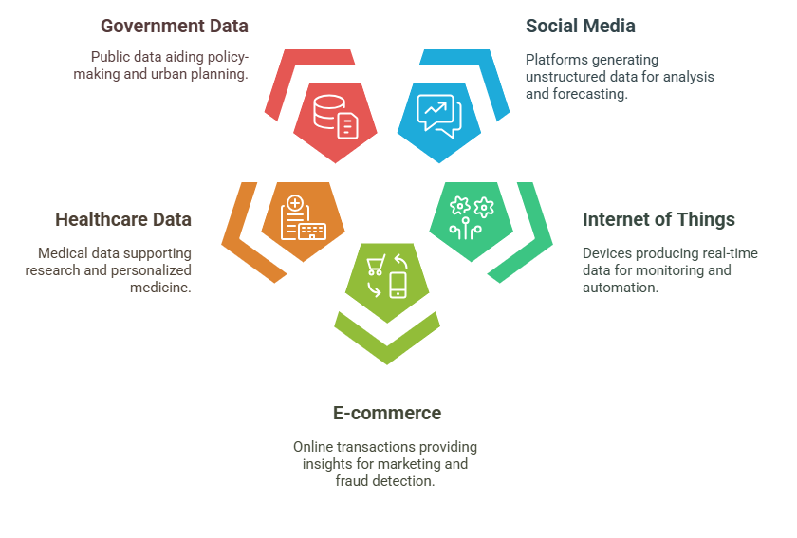
Big Data
Big data refers to massive datasets that are too large or complex to be processed by traditional data processing systems. These datasets are typically generated at a high velocity, in a variety of formats, and often come from diverse sources.
Notes:
Big data refers to extremely large datasets that are often too complex or large to be managed by traditional data processing systems. These datasets are generated at a rapid speed, in various formats, and from different sources. The nature of big data requires advanced tools and technologies to process and analyze the information effectively. There are several major sources of big data that play a crucial role in generating massive amounts of information. Here are five key sources:
1. Social Media Social media platforms like Facebook, Twitter, Instagram, and LinkedIn are some of the biggest contributors to big data. These platforms generate huge amounts of unstructured data daily, including posts, comments, images, videos, and interactions. This data is valuable for various applications such as sentiment analysis, market research, and trend forecasting. By analyzing social media data, businesses can gain insights into customer opinions, preferences, and emerging trends.
2. Internet of Things (IoT) The Internet of Things (IoT) consists of devices and objects that are connected to the internet and can collect and exchange data. These devices include smart sensors, wearables (such as fitness trackers), home automation systems, and connected vehicles. IoT devices generate real-time data, such as temperature readings, location tracking, and device status updates. This data is used for applications like predictive maintenance, where businesses can anticipate equipment failures, as well as for monitoring and automating processes in real time.
3. E-commerce and Online Transactions E-commerce platforms and online businesses generate massive amounts of data from user activities. This data includes product searches, browsing behavior, purchases, and customer reviews. By analyzing this transactional and behavioral data, businesses can offer personalized marketing, detect fraud, and optimize inventory management. For instance, personalized recommendations for products are based on past purchase history and browsing behavior of customers.
4. Healthcare Data The healthcare sector generates enormous data due to advancements in medical technology, electronic health records (EHR), genomics, and wearable health tech. This data includes patient records, diagnostic images (like X-rays), genetic information, and real-time health monitoring data. The data is used for research, personalized medicine, and optimizing treatments. For example, analyzing healthcare data can help doctors predict potential health issues, improve diagnoses, and provide more effective treatments tailored to individual patients.
5. Public and Government Data Governments and public organizations collect vast amounts of data, which can be categorized into many types. This includes census data, weather patterns, traffic reports, economic indicators, and crime statistics. Public and government data is valuable for making informed decisions about policy-making, urban planning, and ensuring public safety. For example, weather data can help with disaster preparedness, while traffic data can assist in improving road infrastructure and reducing congestion.

Slide 4
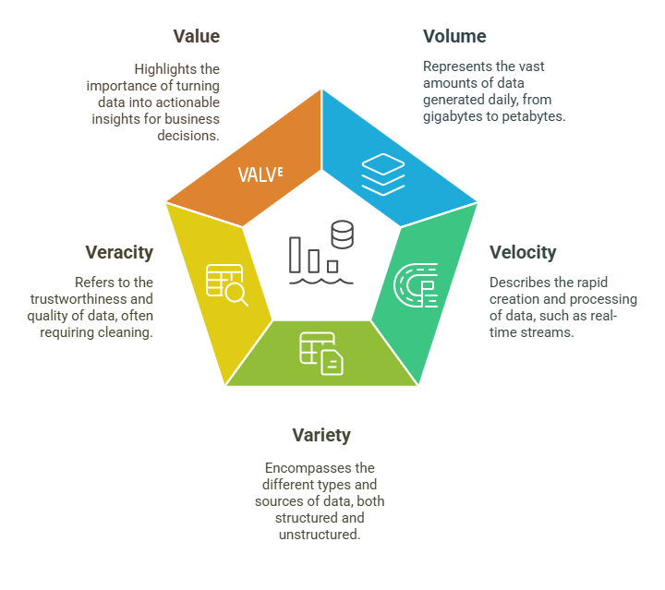
Characteristics of
Big Data
Notes:
Big data is often defined by its five key characteristics, often referred to as the "5 Vs." These characteristics help to describe the nature of big data and the challenges associated with handling and processing it. Here's a breakdown of each characteristic:
1. Volume Volume refers to the sheer amount of data generated every day. The size of the data can range from gigabytes to petabytes (1 petabyte = 1 million gigabytes). Every time someone posts on social media, makes an online transaction, or uses an IoT device, massive amounts of data are being produced. Managing and storing this large amount of data requires significant computing power and storage capacity.
2. Velocity Velocity is the speed at which data is created and processed. In today’s world, data is being generated continuously, often in real-time. For example, sensors in vehicles or smart home devices constantly collect and transmit data. Social media platforms generate real-time data as posts, tweets, and comments are made every second. The challenge here is to process and analyze this data quickly to derive timely insights, especially for applications like predictive analytics and real-time decision-making.
3. Variety Variety refers to the different types of data that big data includes. Data can come in many forms, such as structured data (like spreadsheets or databases), semi-structured data (like emails or XML files), and unstructured data (like images, audio, video, or social media posts). Big data comes from a wide variety of sources, which means it is not always easy to organize or process without the proper tools. Handling such diverse data types requires flexibility and advanced technology to extract meaningful information.
4. Veracity Veracity is the trustworthiness or accuracy of the data. With big data, not all of it is clean, consistent, or reliable. Much of the data may be incomplete, inaccurate, or contradictory. For example, social media data can be biased or misleading. Before big data can be analyzed and used for decision-making, it must be cleaned, filtered, and processed to ensure its quality and reliability. Ensuring veracity helps to avoid misleading conclusions or incorrect insights.
5. Value Value is the most important characteristic of big data. It refers to the ability to turn data into actionable insights that can drive business decisions or innovations. Big data by itself is not useful unless it can be analyzed and interpreted correctly. Through data analysis, businesses can uncover patterns, trends, and correlations that help in decision-making, improving products, or optimizing operations. Without extracting value from big data, the information remains just a collection of raw data without purpose.

Slide 5
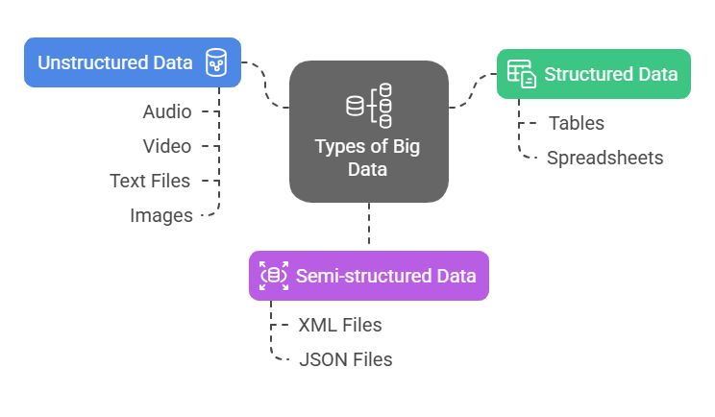
Types of Big Data
Notes:
Big data comes in various formats, and understanding these types is essential for knowing how to handle, process, and analyze it effectively. There are three main types of big data: structured, semi-structured, and unstructured. Let's break down each one:
1. Structured Data Structured data is highly organized and follows a predefined format, making it easy to search, access, and analyze. It is typically stored in databases, such as tables or spreadsheets, where information is arranged in rows and columns. This data can be easily queried using Structured Query Language (SQL), a standard programming language used to manage and manipulate databases. Example: Customer databases where information such as names, addresses, and phone numbers are stored in a table, or inventory management systems that keep track of product details in a structured format.
2. Semi-structured Data Semi-structured data does not follow a rigid structure like structured data, but it still has some organizational properties that allow it to be processed. This data often includes tags, labels, or markers to separate individual data elements, making it easier to extract and interpret. It is not as easily organized as structured data but offers more flexibility. Example: Email data, where information is stored in an unstructured format but still includes headers, dates, and subjects; web logs, which record user activities in a semi-organized way; and social media posts, where text can be combined with tags, hashtags, and metadata.
3. Unstructured Data Unstructured data is raw, unorganized, and does not follow any predefined format or structure. This type of data is much harder to process and analyze because it lacks the consistent, easily identifiable patterns found in structured data. Unstructured data includes anything from text, images, videos, and audio files to social media content and customer feedback. Example: Audio files, video content, text documents, images, and social media posts that don’t have a defined structure. For instance, a tweet on Twitter or a comment on Facebook is considered unstructured because it can contain a mix of text, emojis, hashtags, and informal language.

Slide 6
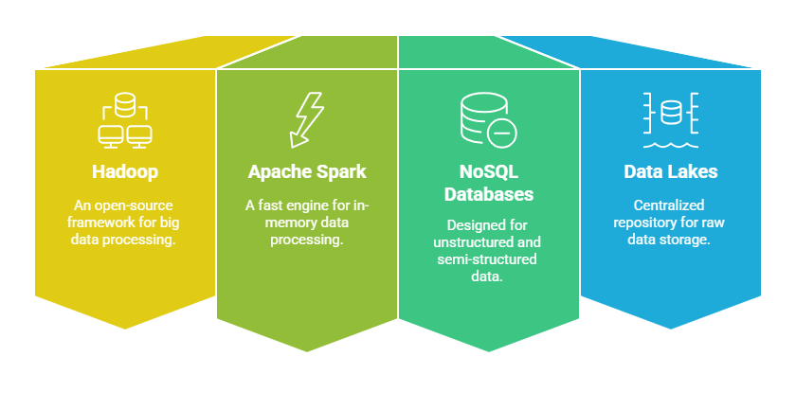
Widely used tools for Big data management
Notes:
As the volume and complexity of big data continue to grow, specialized tools and technologies are required to manage, store, and process the data efficiently. Below are some of the key tools used to handle big data:
1. Hadoop Hadoop is an open-source framework designed to store and process large datasets across many computers, or clusters, in a distributed way. It allows data to be split and stored across multiple machines, making it scalable and cost-effective for handling massive amounts of data. Hadoop uses a method called MapReduce for processing data, which breaks down tasks into smaller, parallelizable pieces that can be processed simultaneously. 2. Apache Spark Apache Spark is another powerful open-source tool, but it is designed for fast, in-memory data processing. Unlike Hadoop, which processes data in batches, Spark can process data in real-time, making it faster and more efficient for tasks that require quick insights. Spark also supports machine learning, graph processing, and SQL-based querying, allowing it to handle a wide range of big data processing tasks.
3. NoSQL Databases (e.g., MongoDB, Cassandra) NoSQL databases are designed to handle large volumes of unstructured or semi-structured data, which is common in big data environments. These databases are more flexible than traditional relational databases because they don’t require a fixed schema and can store a variety of data types. They are also scalable, meaning they can handle increased data loads by adding more servers to the system. 4. Data Lakes A data lake is a centralized repository where large amounts of raw, unprocessed data are stored in their native format. Unlike traditional databases, data lakes allow businesses to store data in its raw form (structured, semi-structured, or unstructured) without the need to organize it first. This makes them a flexible solution for companies that want to store diverse types of data and analyze it later. Popular platforms for building data lakes include Amazon Web Services (AWS) S3 and Microsoft Azure Data Lake.

Slide 7
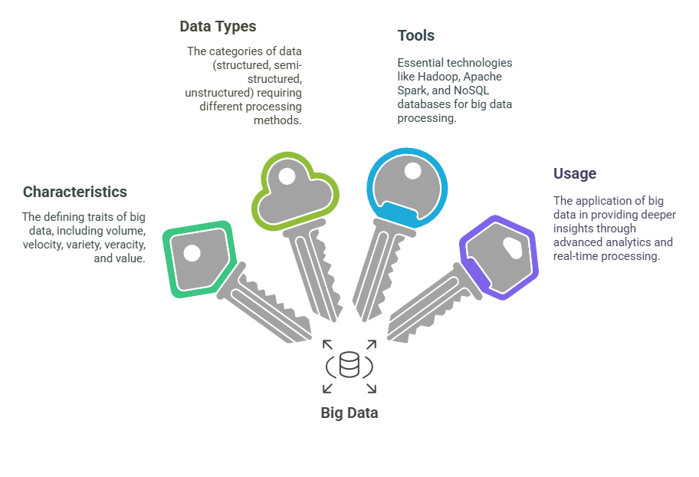
4 Key Learning Points of this Lesson
Notes:
Understanding Big Data Big data refers to massive and complex datasets that are beyond the capacity of traditional data systems to process due to their sheer size, speed, and variety. These datasets often come from a wide range of sources and require specialized tools and techniques for management and analysis.
Key Characteristics of Big Data The five key characteristics of big data are:
Volume: Refers to the huge amount of data being generated.
Velocity: The speed at which data is generated and needs to be processed.
Variety: The different types of data, including structured, semi-structured, and unstructured.
Veracity: The quality and reliability of the data.
Value: The ability to extract meaningful insights from the data.
Types of Big Data Big data comes in three main types:
Structured Data: Organized in predefined formats, easy to process.
Semi-structured Data: Data with some structure but not as rigid, often including tags or markers.
Unstructured Data: Raw, unorganized data such as images, videos, and social media posts that need processing to become useful.
Tools for Big Data Handling and analyzing big data requires specialized tools. These include:
Hadoop: A framework for distributed storage and processing of large datasets.
Apache Spark: A fast data processing engine, especially suited for real-time processing.
NoSQL Databases: Flexible databases like MongoDB and Cassandra, designed for handling unstructured and semi-structured data.
Data Lakes: Large repositories that store raw data in its native format, offering flexibility for future analysis.

Slide 8
Thank You!
Shahriar’s Analytical Academy

